Slide 1

Sales prediction
Walmart Weekly Sales Prediction

Slide 2

Walmart Inc. is an American multinational retail corporation that operates a chain of hypermarkets (also called supercenters), discount department stores, and grocery stores in the United States, headquartered in Bentonville, Arkansas. The company was founded by Sam Walton in nearby Rogers, Arkansas in 1962 and incorporated under Delaware General Corporation Law on October 31, 1969. It also owns and operates Sam's Club retail warehouses.
Notes:
Walmart is the world's largest company by revenue, with about US $570 billion in annual revenue, according to the Fortune Global 500 list in May 2022. As of July 31, 2022, Walmart has 10,585 stores and clubs in 24 countries, operating under 46 different names. Out of which we have chosen 45 stores for basic analysis.

Slide 3
Data fields
STORE
DATE
WEEKLY_SALES
HOLIDAY_FLAG
TEMPERATURE
FUEL_PRICE
CPI
UNEMPLOYMENT
Notes:
Store: Store Numbers ranging from 1 to 45.
Date: The Week of Sales. It is in the format of dd-mm-yyyy. The date starts from 05-02-2010.
Weekly_Sales: The sales of the given store in the given week.
Holiday_Flag: If the week has a special Holiday or not. 1-The week has a Holiday 0-Fully working week Holiday events is given in.
Temperature: Average Temperature of the week of sales.
Fuel_Price: Price of the Fuel in the region of the given store.
CPI: Customer Price Index.
Unemployment: Unemployment of the given store region.

Slide 4
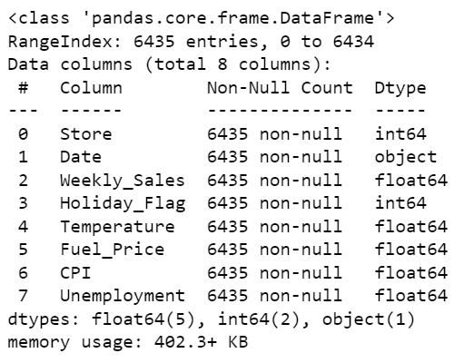
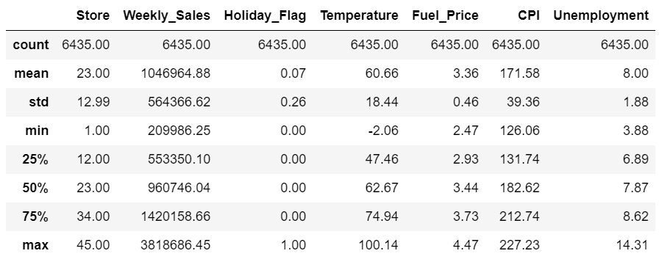
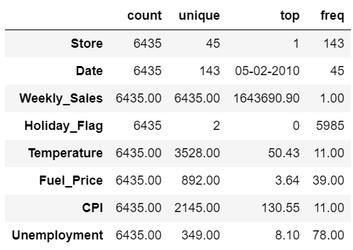
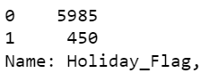
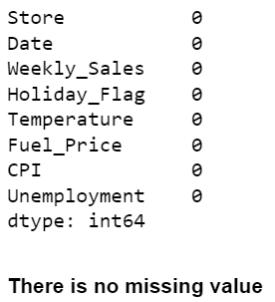
Descriptive Data Analysis
Notes:
The dataset has 8 features with 6435 records, zero missing value and zero duplicated value.
Our target feature is weekly sales and the rest of the features are our predictors
We also need to identify the possible effects of CPI as it serves a crucial role in the economy as it provides a standardized way to quantify inflation

Slide 5
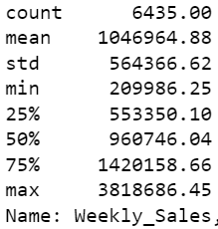
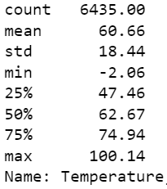
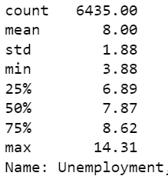
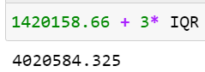
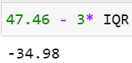
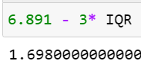
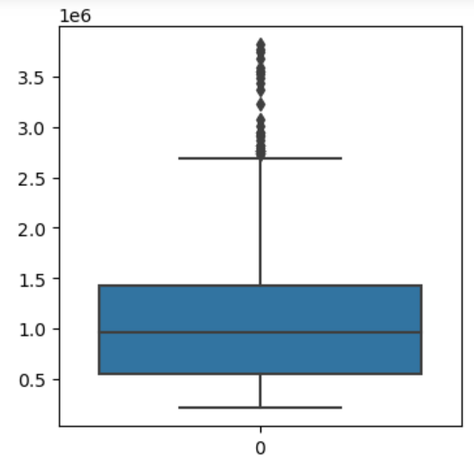
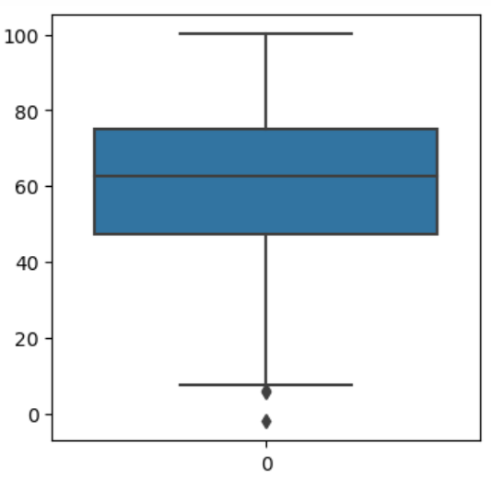
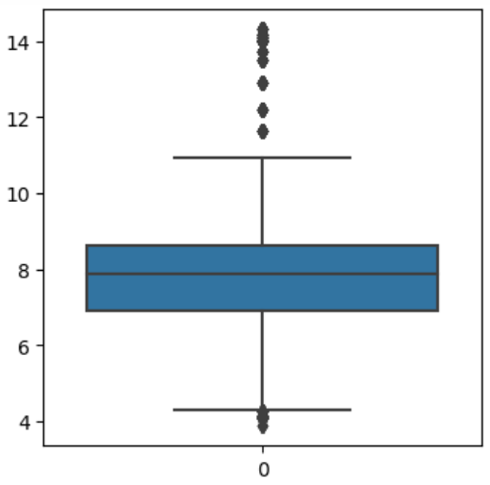
outliers
Weekly Sales
Temperature
Unemployment
Notes:
Weekly sales There are 34 possible outliers, but no extreme outliers and no significant gap between the fence and potential outliers and there are continuous values that make sense, so we leave it as typical high values.
Temperature There are 3 possible outliers, but no extreme outliers and no significant gap between the fence and potential outliers and there are continuous values that make sense, so we leave it as typical low values.
Unemployment
After searching the information online, we found that the unemployment rate has fluctuated between 3% and 15% in the past 20 years. These outliers are within the normal ranges. So we decided to keep them.
No outliers have been found with CPI and Fuel Price features

Slide 6
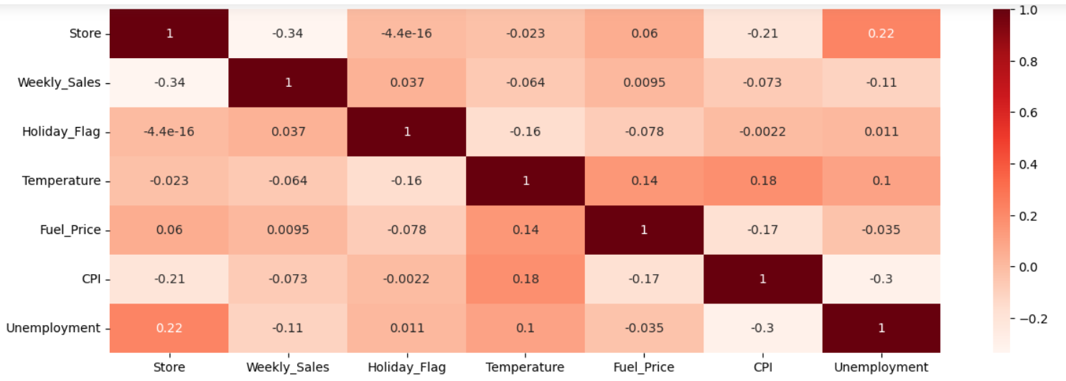
Correlation
Notes:
Holiday Flag has a very weak positive correlation (0.036891) with "Weekly_Sales.“
"Temperature" has a weak negative correlation (-0.063810) with "Weekly_Sales," suggesting that as temperature increases, weekly sales tend to decrease slightly.
Fuel price has a weak positive correlation (0.060023) with "Store," which suggests that as fuel prices increase, sales at different stores may also increase slightly.
CPI has a moderately negative correlation (-0.209492) with "Store," implying that as the CPI decreases, sales at different stores tend to increase.

Slide 7
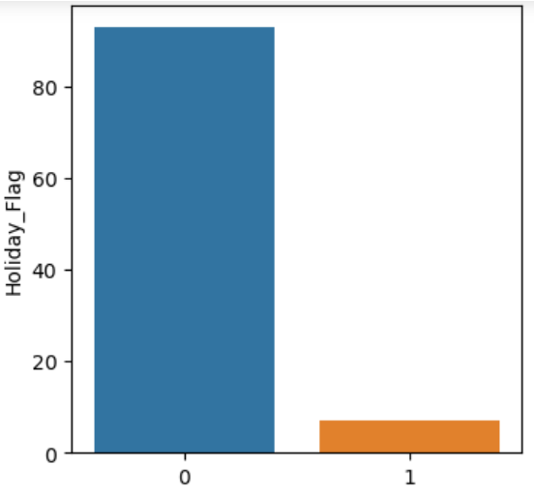
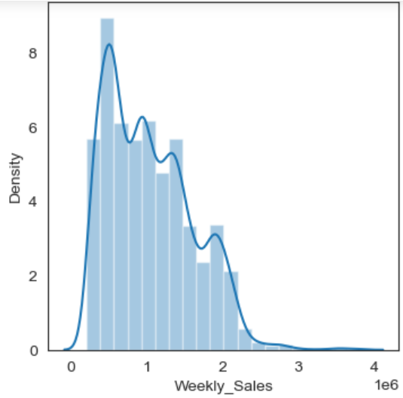
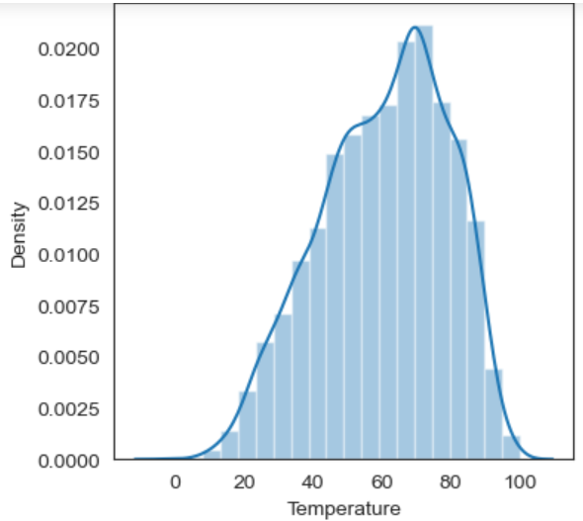
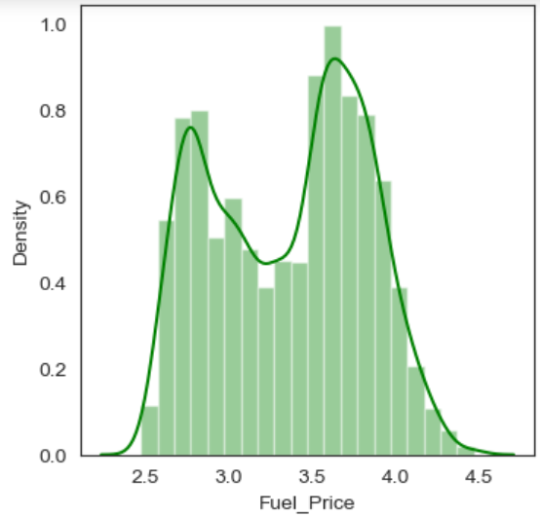
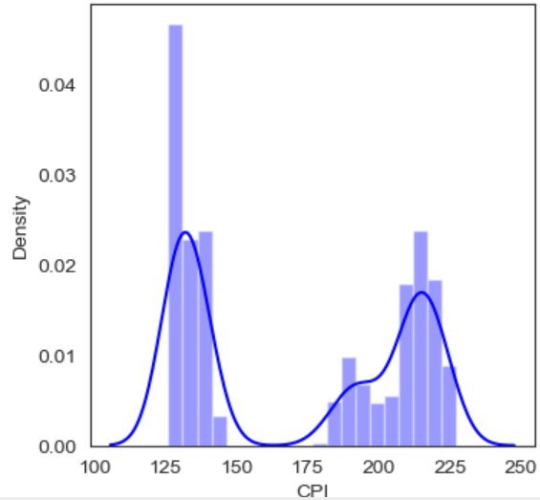
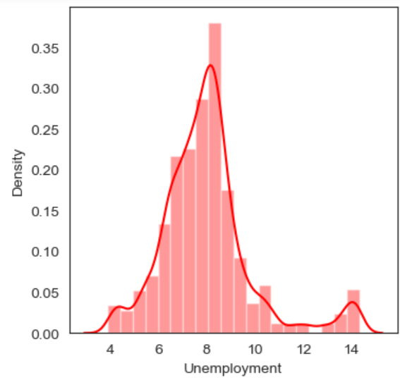
Univariate Analysis
Notes:
Holiday Flag
1-The week has a Holiday, 0-The week no Holiday
0-5985 1-450
Weekly Sales
Temperature
Temperatures between 60℉ and 80℉ degrees are most frequent.
Fuel Price
Fuel prices are mainly concentrated between 3.5 and 4.
CPI
The frequency of CPI between 125 and 130 is significantly higher than many others.
Unemployment
Unemployment rate are mainly concentrated between 7 and 9.

Slide 8
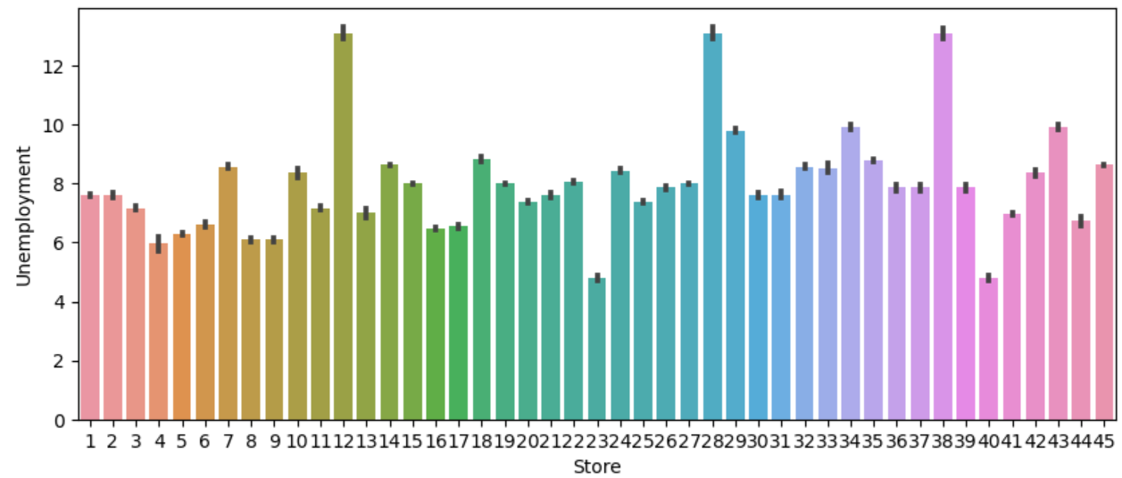
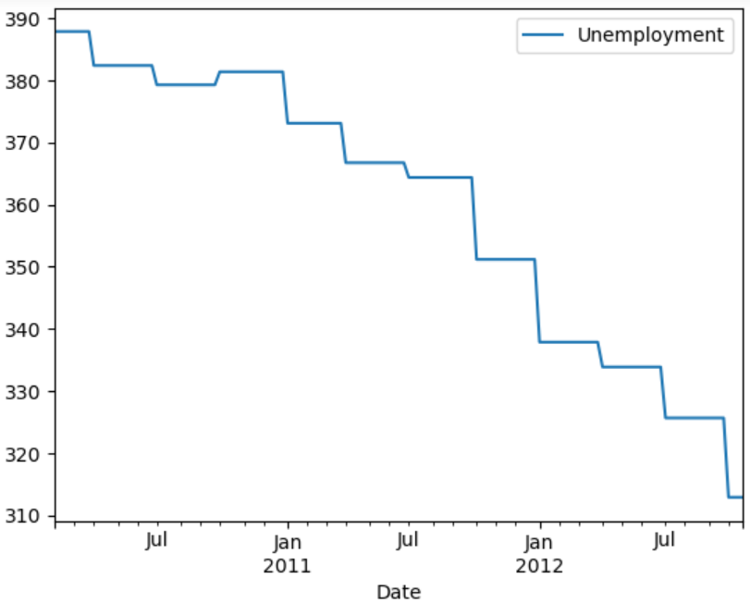
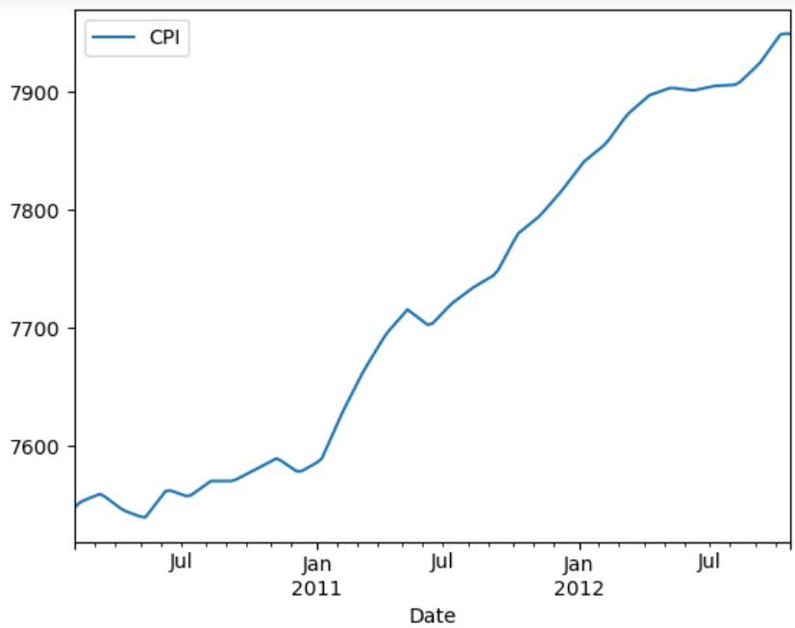
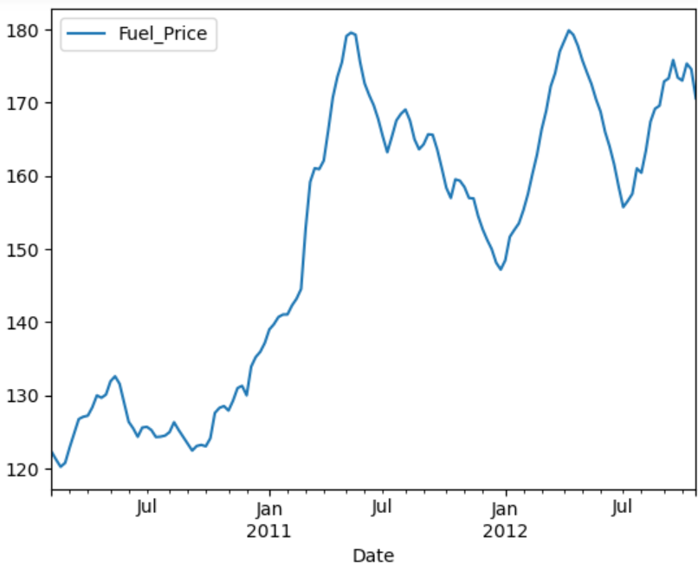
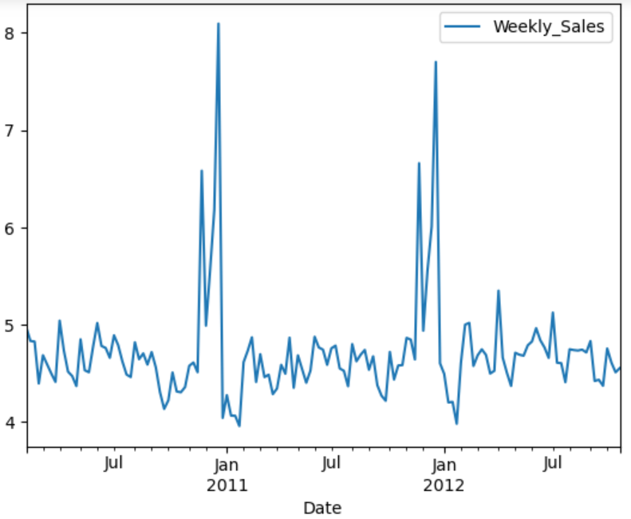
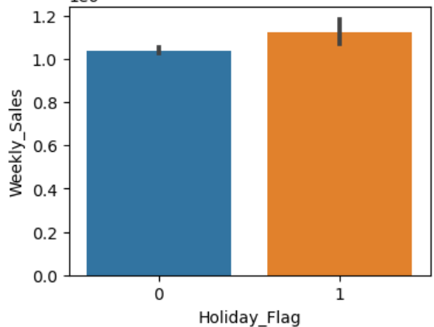
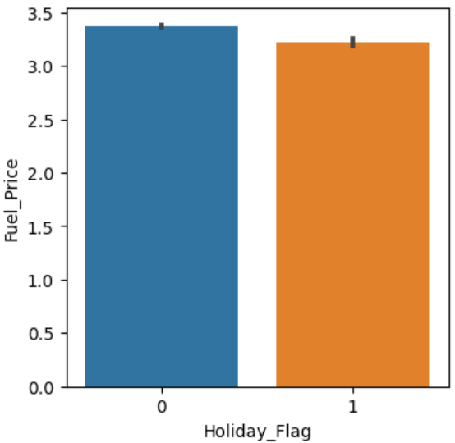
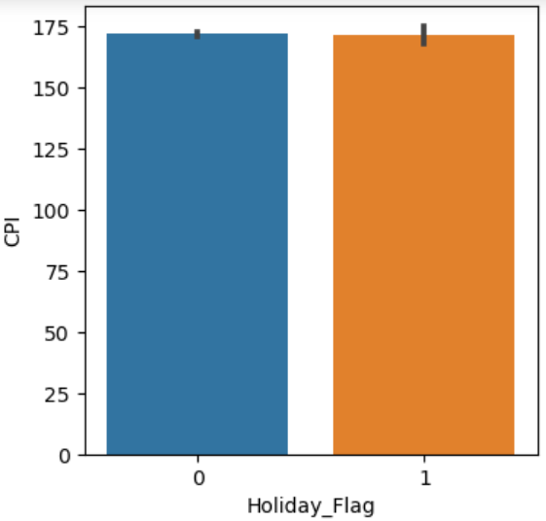
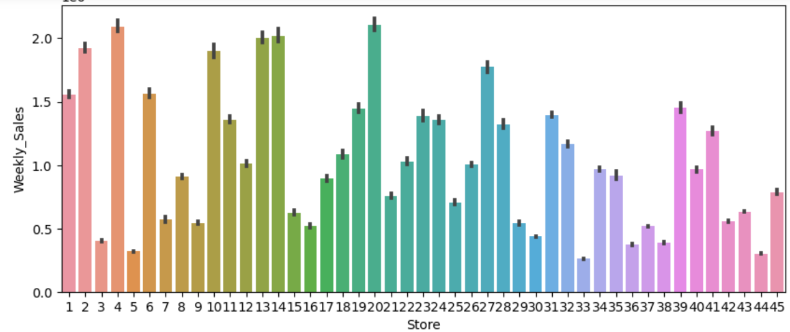
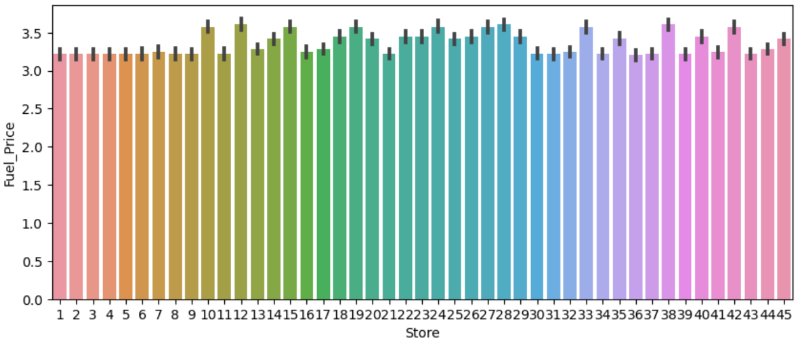
Bivariate analysis – Numeric - Categorical Analysis
Notes:
Weekly_Sales VS Date
Sales every winter, especially from Black Friday to Christmas, are much higher than during other holidays and other working days.
Weekly_Sales VS Holiday_Flag
If there is a memorable holiday in a week, then the weekly sales this week are higher than on working days.
Fuel_Price VS Date
Oil prices have shown an overall upward trend over time. It accelerated from January 2011 and fell back in May 2011. Half a year later, in January 2012, it accelerated again and fell again in May. Generally speaking, oil prices will rise rapidly starting from January every year and will fall back in May, but the overall price is on an upward trend every year.
CPI VS Date
As time goes by, the CPI (Customer Price Index) generally shows an upward trend. When oil prices rise rapidly, the CPI also rises rapidly. When oil prices fall or rise slowly, the CPI rises slowly. The rapid rise in oil prices may stimulate the economy and accelerate the rise in the CPI.
Unemployment VS Date
Over time, the unemployment rate continues to decline, possibly because economic development continues to rise. At the same time, the CPI continues to rise, possibly because the economy is rising, and the unemployment rate continues to decline, both of which will indirectly lead to the CPI rising.
Fuel_Price VS Holiday_Flag
On weeks with holidays, fuel prices will be lower than on weeks without holidays.
CPI VS Holiday_Flag
Weeks with or without holidays will not affect the CPI.
Weekly_Sales VS Store
The top 5 stores by weekly sales are: #20, #4, #14, #13, #2. The bottom 5 stores by weekly sales are: #33, #44, #5, #36, #38.
Fuel_Price VS Store
There is not much difference in fuel prices between stores.
Unemployment VS Store
The stores in the three regions with the highest unemployment rates are #12, #28, #38. The stores in the two regions with the lowest unemployment rates are #23 and #40. The weekly sales of the three stores with the highest unemployment rate are not in the top ten of weekly sales, but the weekly sales of the two stores with the lowest unemployment rate are not in the top ten of weekly sales either. It proves that a higher unemployment rate may affect store sales, but this impact is relatively small and not a major influencing factor.

Slide 9
Hypothesis Testing
Business Problem: Is there a significant difference between the weekly sales of the week with holidays and the week without holidays? Is this difference in the mean statistically significant or it just due to random chance? H0: There have no significant difference between the weekly sales of the week with holidays and the week without holidays.
Normality Test
Equal Variances Test
Welch’s T-test
Notes:
Normality
Since p-values are less than 0.05, we can to reject the null hypothesis and conclude that these two groups are not normally distributed. Since the sample size is large enough (≥30). We can rely on the Central Limit Theorem.
Equal variance
Since p-value=0.0012 is less than 0.05, we can to reject the null hypothesis and conclude that these two groups have significant difference in their variances. So choose Welch's T-Test(Satterthwaite).
Since p-value=0.0076 is less than 0.05, we can to reject the null hypothesis and conclude that there have significant difference between the weekly sales of the week with holidays and the week without holidays. Same as the plot shows, If there is a memorable holiday in a week, then the weekly sales this week are higher than on working days.

Slide 10
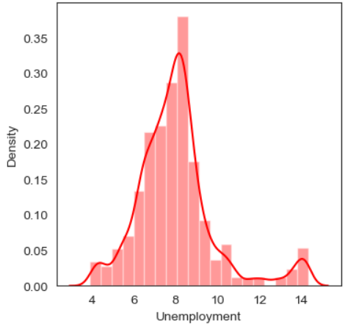
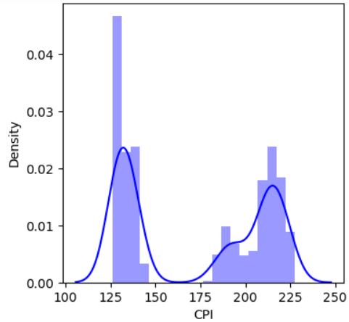
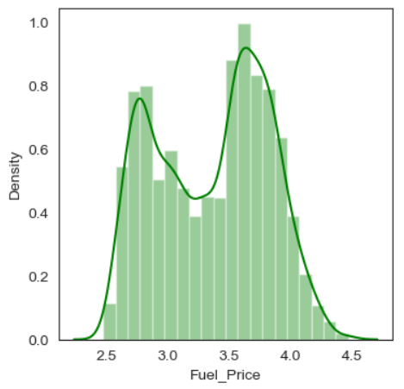
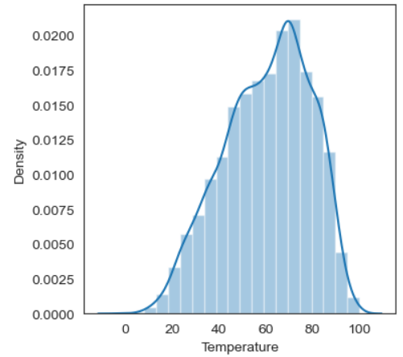
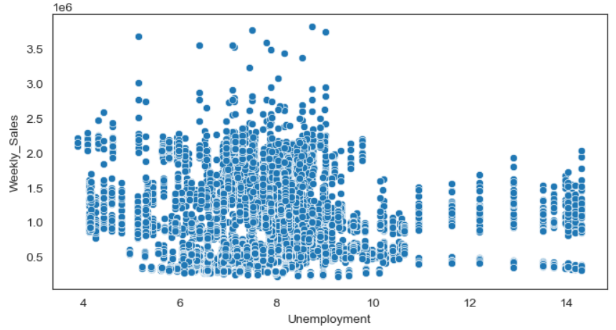
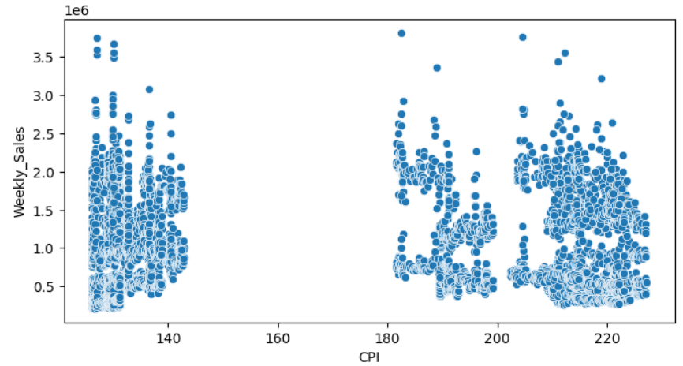
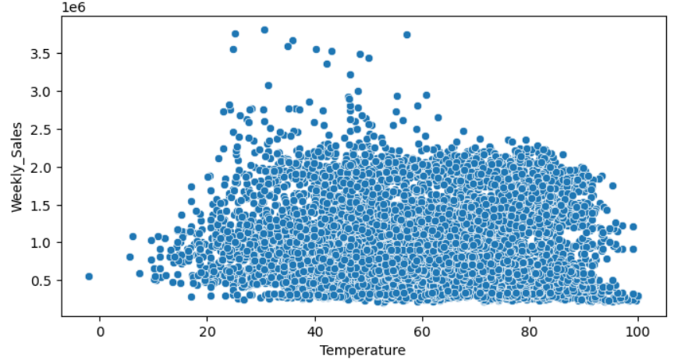
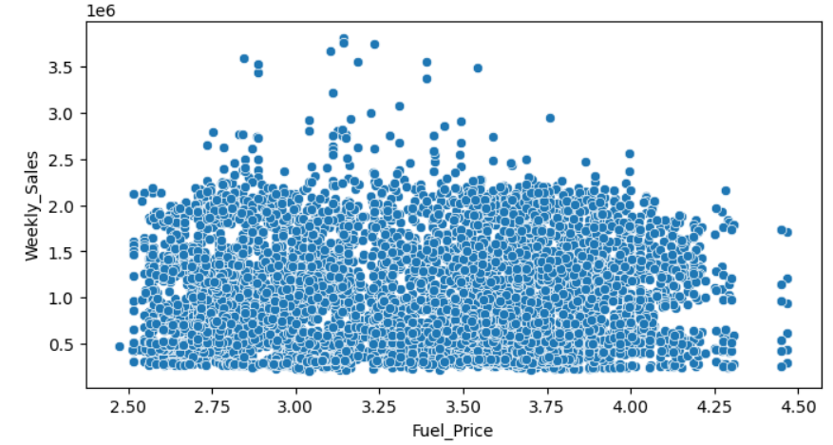
Bivariate analysis – Numeric - numeric Analysis
Notes:
Weekly_Sales VS Date
Sales every winter, especially from Black Friday to Christmas, are much higher than during other holidays and other working days.
Weekly_Sales VS Holiday_Flag
If there is a memorable holiday in a week, then the weekly sales this week are higher than on working days.
Fuel_Price VS Date
Oil prices have shown an overall upward trend over time. It accelerated from January 2011 and fell back in May 2011. Half a year later, in January 2012, it accelerated again and fell again in May. Generally speaking, oil prices will rise rapidly starting from January every year and will fall back in May, but the overall price is on an upward trend every year.
CPI VS Date
As time goes by, the CPI (Customer Price Index) generally shows an upward trend. When oil prices rise rapidly, the CPI also rises rapidly. When oil prices fall or rise slowly, the CPI rises slowly. The rapid rise in oil prices may stimulate the economy and accelerate the rise in the CPI.
Unemployment VS Date
Over time, the unemployment rate continues to decline, possibly because economic development continues to rise. At the same time, the CPI continues to rise, possibly because the economy is rising, and the unemployment rate continues to decline, both of which will indirectly lead to the CPI rising.
Fuel_Price VS Holiday_Flag
On weeks with holidays, fuel prices will be lower than on weeks without holidays.
CPI VS Holiday_Flag
Weeks with or without holidays will not affect the CPI.
Weekly_Sales VS Store
The top 5 stores by weekly sales are: #20, #4, #14, #13, #2. The bottom 5 stores by weekly sales are: #33, #44, #5, #36, #38.
Fuel_Price VS Store
There is not much difference in fuel prices between stores.
Unemployment VS Store
The stores in the three regions with the highest unemployment rates are #12, #28, #38. The stores in the two regions with the lowest unemployment rates are #23 and #40. The weekly sales of the three stores with the highest unemployment rate are not in the top ten of weekly sales, but the weekly sales of the two stores with the lowest unemployment rate are not in the top ten of weekly sales either. It proves that a higher unemployment rate may affect store sales, but this impact is relatively small and not a major influencing factor.

Slide 11
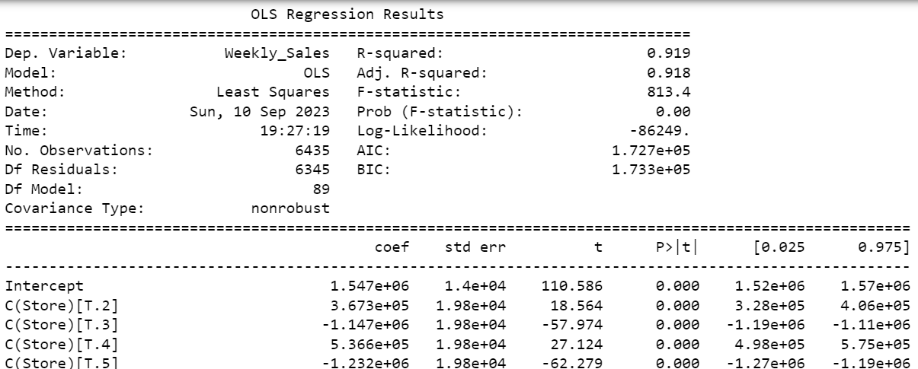
Multivariate analysis
Regression Test
Business Problem: Is there a significant relationship between the store, holiday and the weekly sales? H0: There have no significant relationship between them.
Since p-value is less than 0.05, we can reject the null hypothesis and conclude that there have a significant relationship between them. The weekly sales of each store will differ depending on whether the week contains holidays.
Notes:
The regression model is attempting to understand how the independent variables (predictors) influence or explain the variation in weekly sales.
An R-squared of 0.919 means that approximately 91.9% of the variance in weekly sales is explained by the independent variables in the model
An adjusted R-squared of 0.918 indicates that, after adjusting for the number of predictors, the model still explains a high percentage of the variance in weekly sales.
A high F-statistic (813.4 ) indicates that at least one of the independent variables in the model is statistically significant in explaining the variation in the dependent variable.

Slide 12
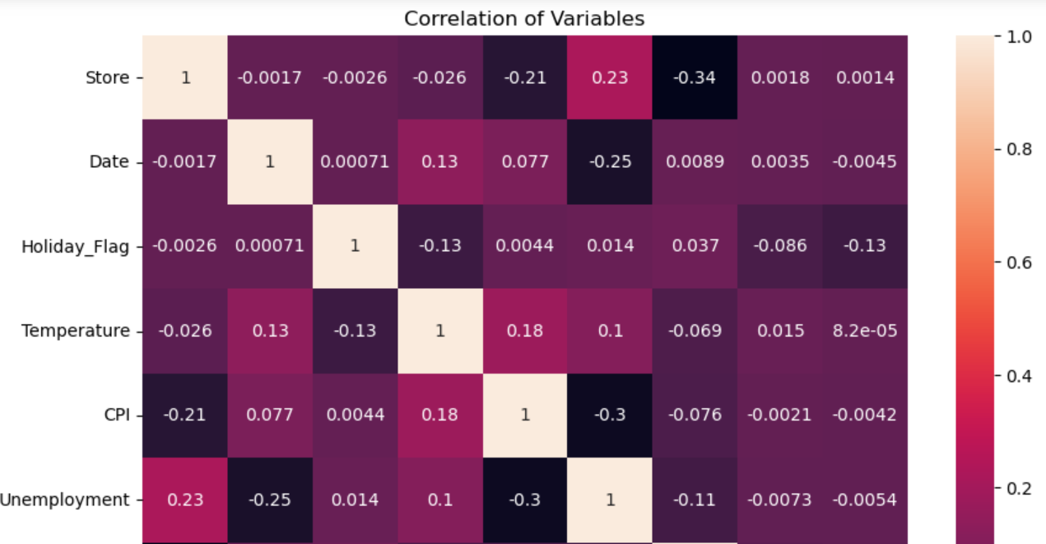
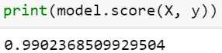
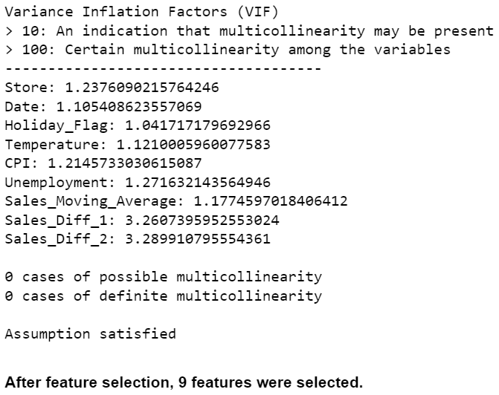
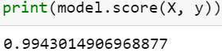
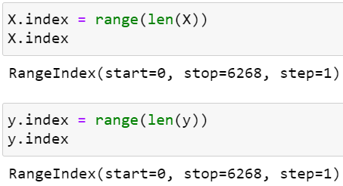
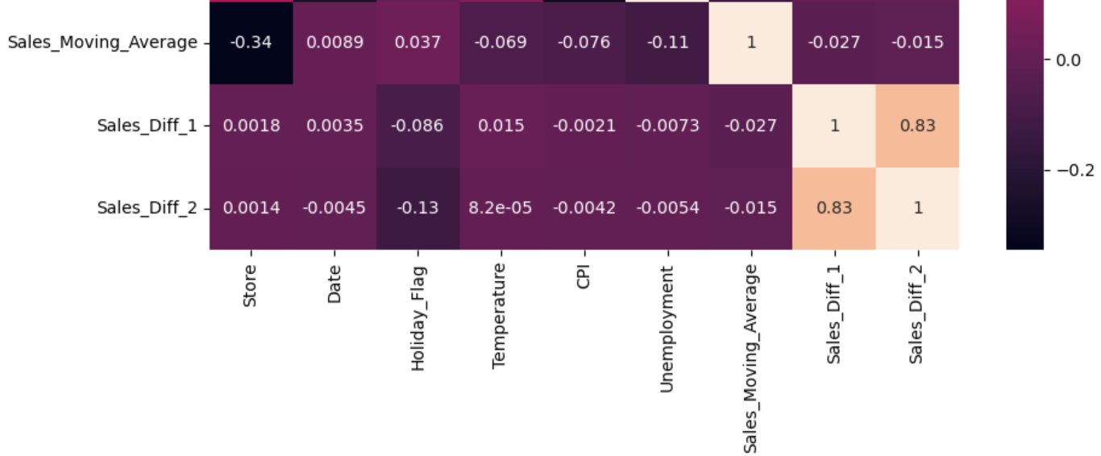
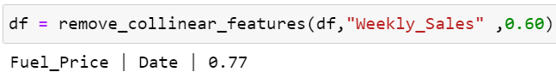
Feature Selection / Engineering
Handling Outlier: LOF
Check VIF score
Scale Data
Remove Collinear Features
Notes:
After VIF score check Assumption 2: Little to no multicollinearity among predictors

Slide 13
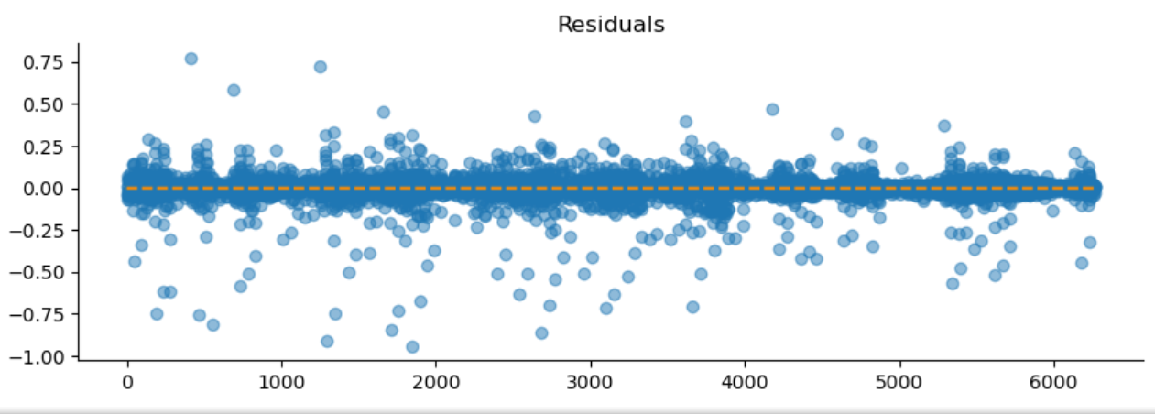
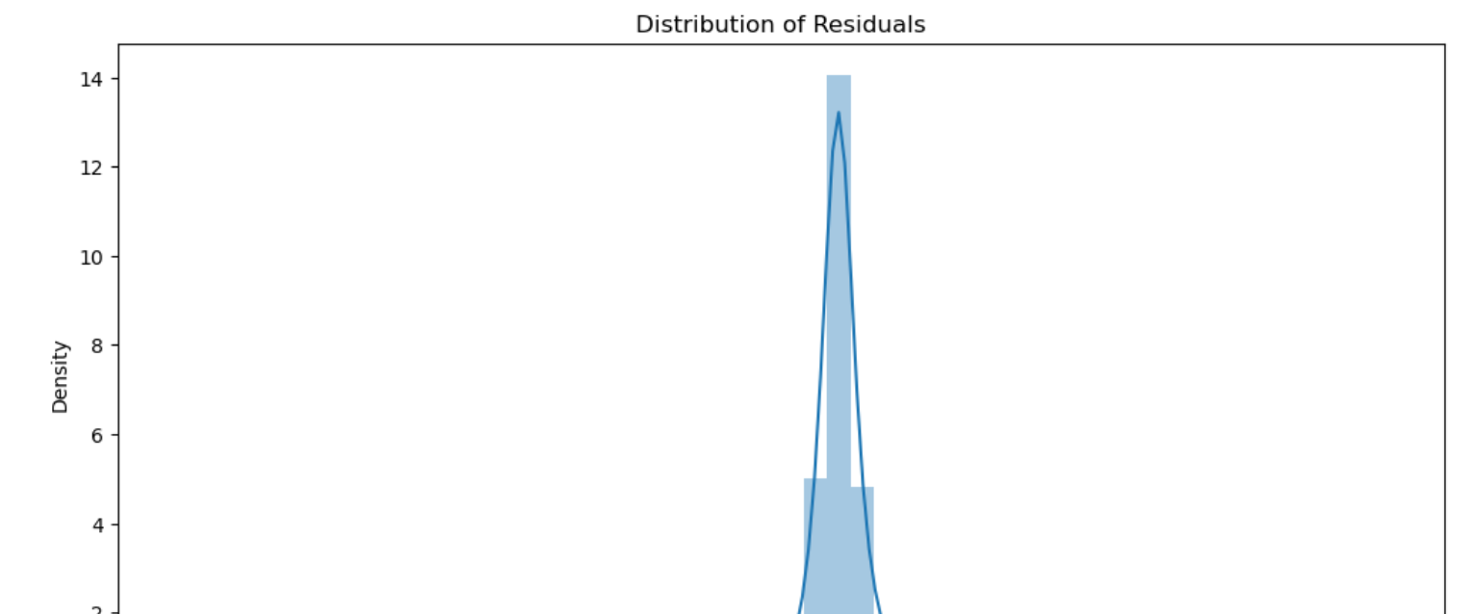
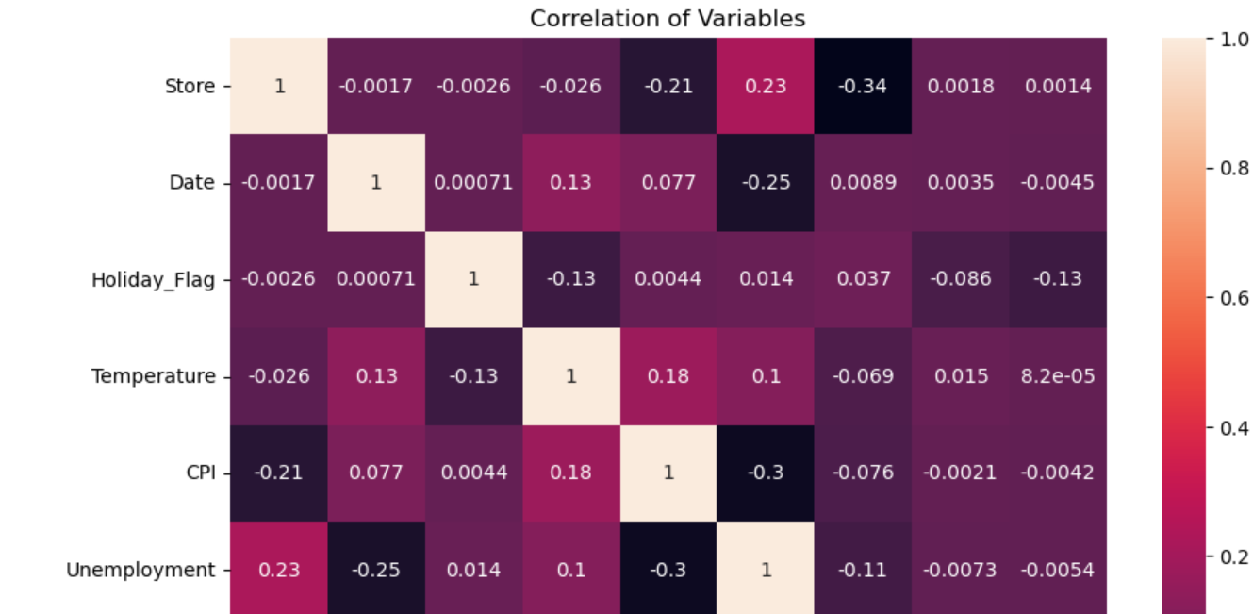





Model Selection Testing Multiple Linear Regression Assumptions
Linearity Assumption
Generally does not violate homoscedasticity
There is a linear relationship, the linearity assumption has been met.
No Multicollinearity among Predictors
Normality of the Error Terms
Notes:
Assumption 1: Linear Relationship between the Target and the Feature Checking with a scatter plot of actual vs. predicted. Predictions should follow the diagonal line.
Assumption 2: Little to no multicollinearity among predictors
Assumption 3: The error terms are normally distributed
Using the Anderson-Darling test for normal distribution
p-value from the test - below 0.05 generally means non-normal: 0.0
Residuals are not normally distributed
Assumption 4: Homoscedasticity of Error Terms
Residuals should have relative constant variance
Assumption 5: No Autocorrelation

Slide 14
Executive Summary
If there is a memorable holiday in a week, then the weekly sales this week are higher than on working days.
An incrase in the CPI index will increase store sales
Higher unemployment rate may affect store sales, but this impact is relatively small and not a major influencing factor
Temperatures between 60℉ and 80℉ degrees are most frequent. Higher store sales occur when the temperature is 20℉ to 60℉.

